Slide 1
Self-Correcting Self-Consuming Loops
For Generative Model Training
Nate Gillman, Michael Freeman, Daksh Aggarwal, Chia-Hong Hsu, Calvin Luo, Yonglong Tian, Chen Sun
ICML 2024, Vienna
Project page: https://nategillman.com/sc-sc.html

Slide 2
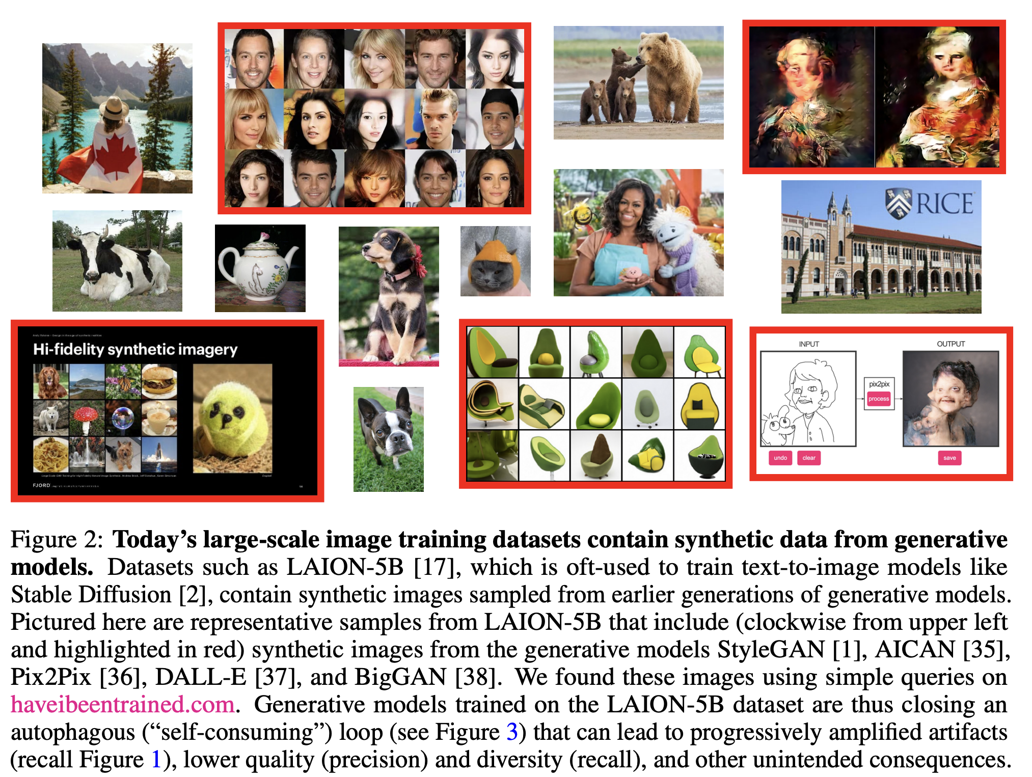
Synthetic data is flooding the web, where it (unknowingly) becomes training data…
Sina Alemohammad et al.
https://arxiv.org/abs/2307.01850

Slide 3
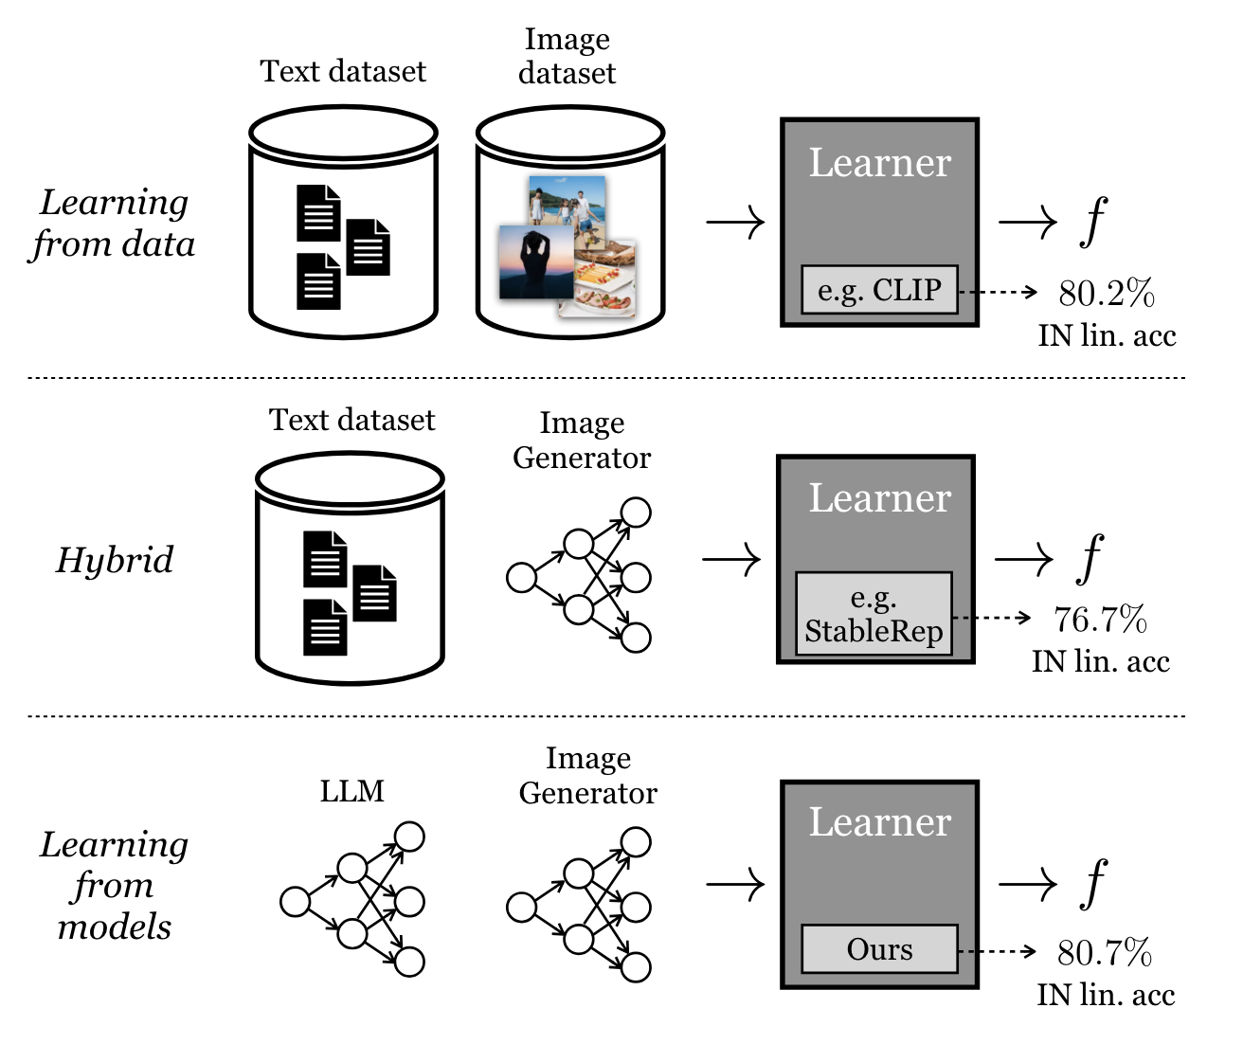
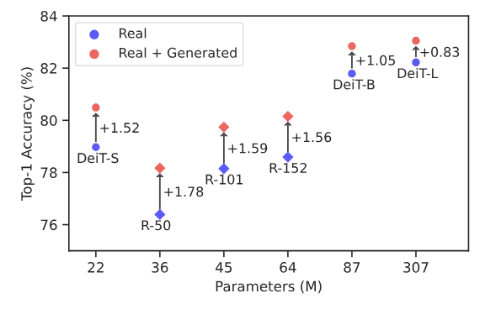
They can be helpful to learn discriminative models…
Azizi et al. https://arxiv.org/abs/2304.08466
Tian and Fan et al. https://arxiv.org/abs/2312.17742

Slide 4
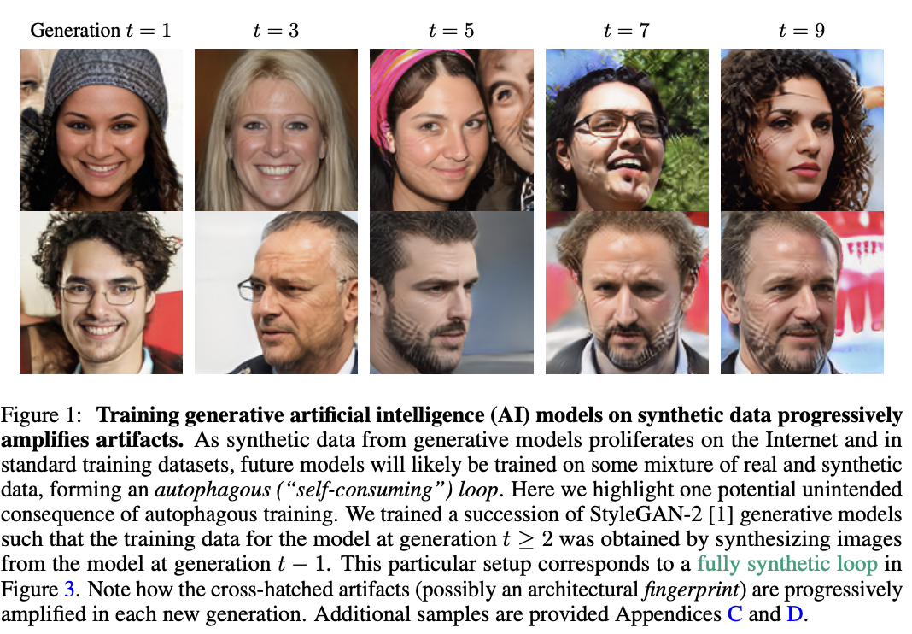
… but “self-consuming generative models go MAD”!!
StyleGAN-2 re-trained from synthetic images sampled from the previous generation model.
Sina Alemohammad et al.
https://arxiv.org/abs/2307.01850
Notes:
This is a full synthetic loop

Slide 5
… but “self-consuming generative models go MAD”!!
StyleGAN-2 re-trained from synthetic images sampled from the previous generation model.
Sina Alemohammad et al.
https://arxiv.org/abs/2307.01850
Notes:
This is a full synthetic loop

Slide 6
… but “self-consuming generative models go MAD”!!
StyleGAN-2 re-trained from synthetic images sampled from the previous generation model.
Sina Alemohammad et al.
https://arxiv.org/abs/2307.01850
Notes:
This is a full synthetic loop

Slide 7
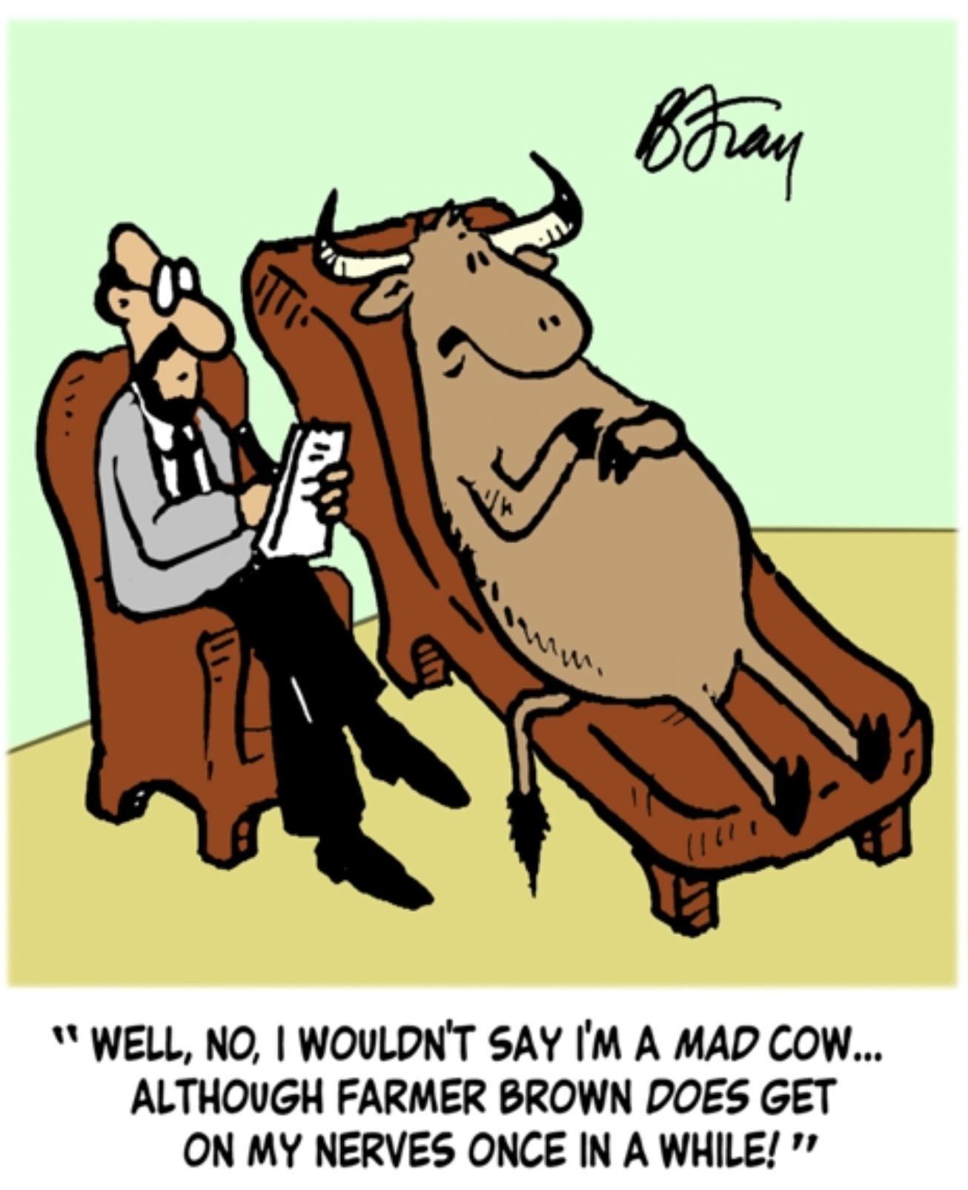
How to stop the MADness?
Mix in “sufficient” portion of real data during each generation. (Alemohammad et al.; Bertrand et al.)
Can we somehow (auto-)correct the synthesized examples?
https://www.cartoonstock.com/cartoon?searchID=CS116071&type=store
Notes:
This is a full synthetic loop

Slide 8
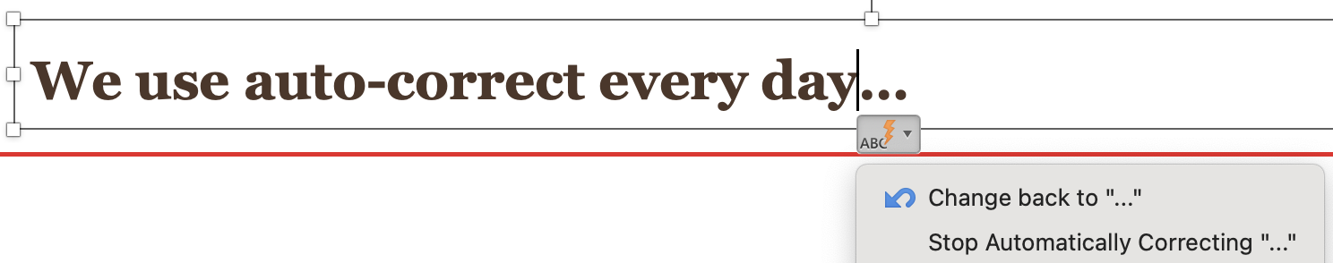
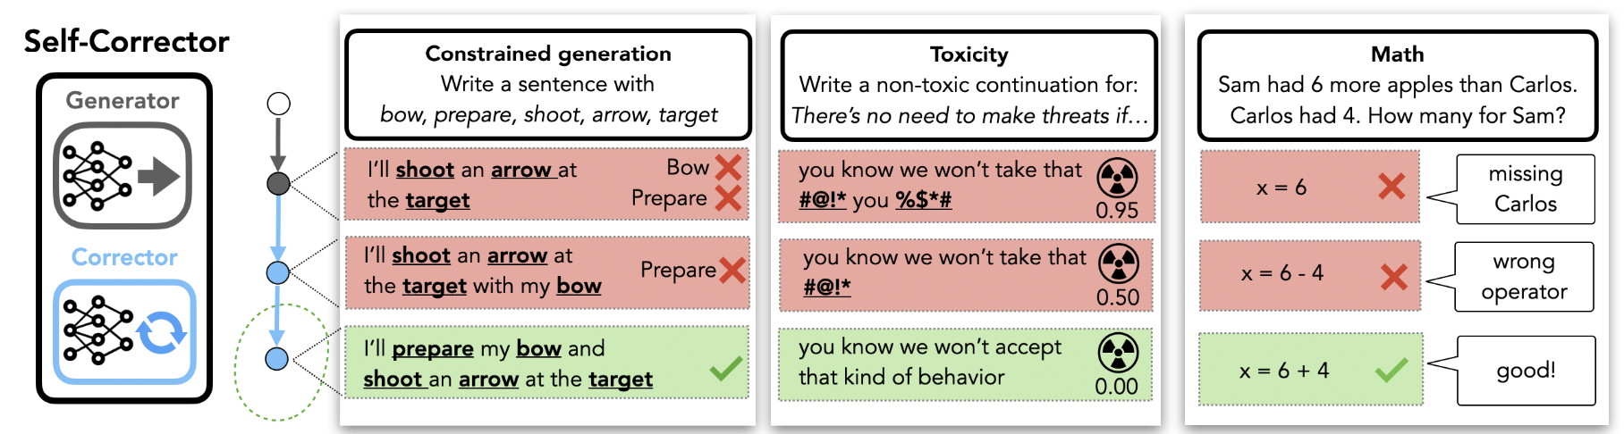
We use auto-correct every day…
For video generation, can we rely on the law of physics for correction?
Welleck and Lu et al., https://arxiv.org/abs/2211.00053
Notes:
This is a full synthetic loop

Slide 9
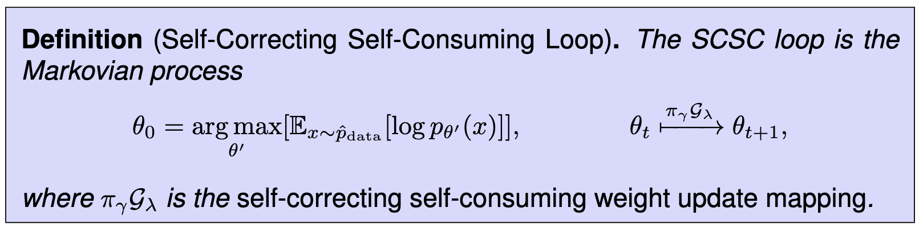
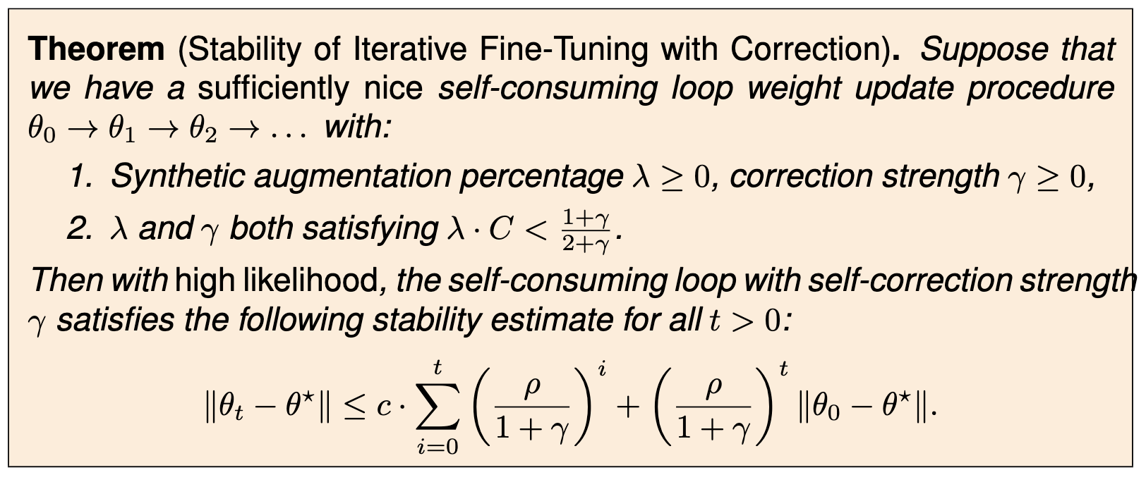
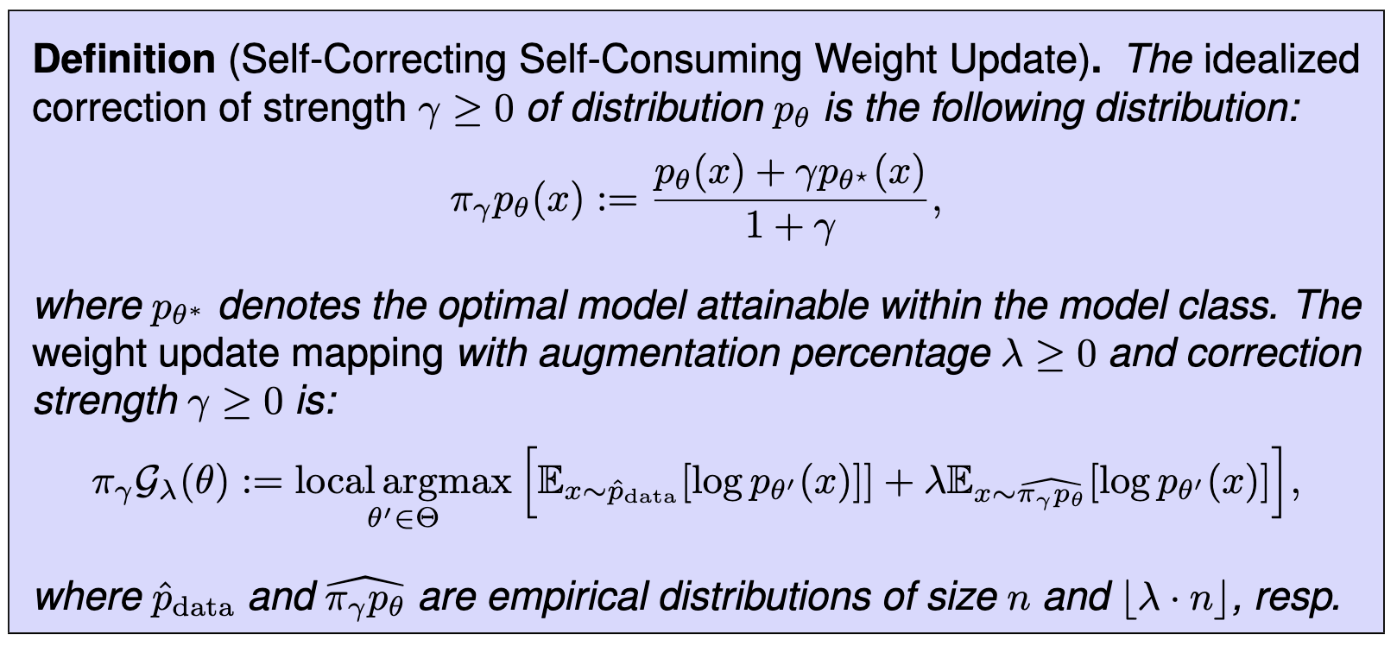
Why self-correct? Our theoretical results…

Slide 10
Why self-correct? Our theoretical results…

Slide 11
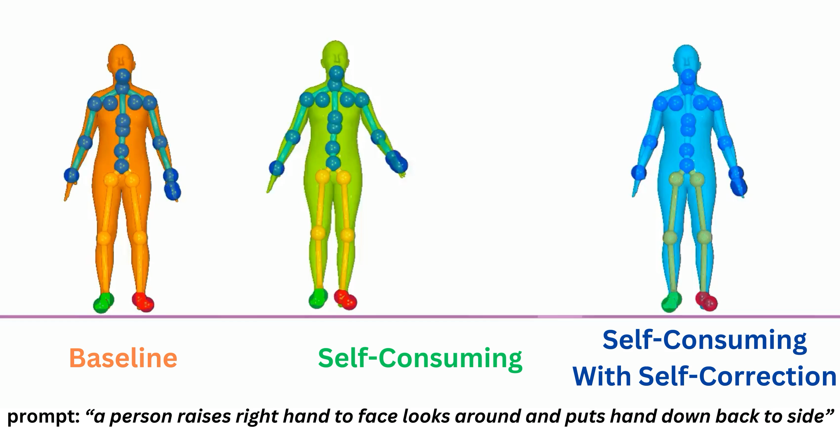
We start from human motion synthesis

Slide 12
We start from human motion synthesis

Slide 13
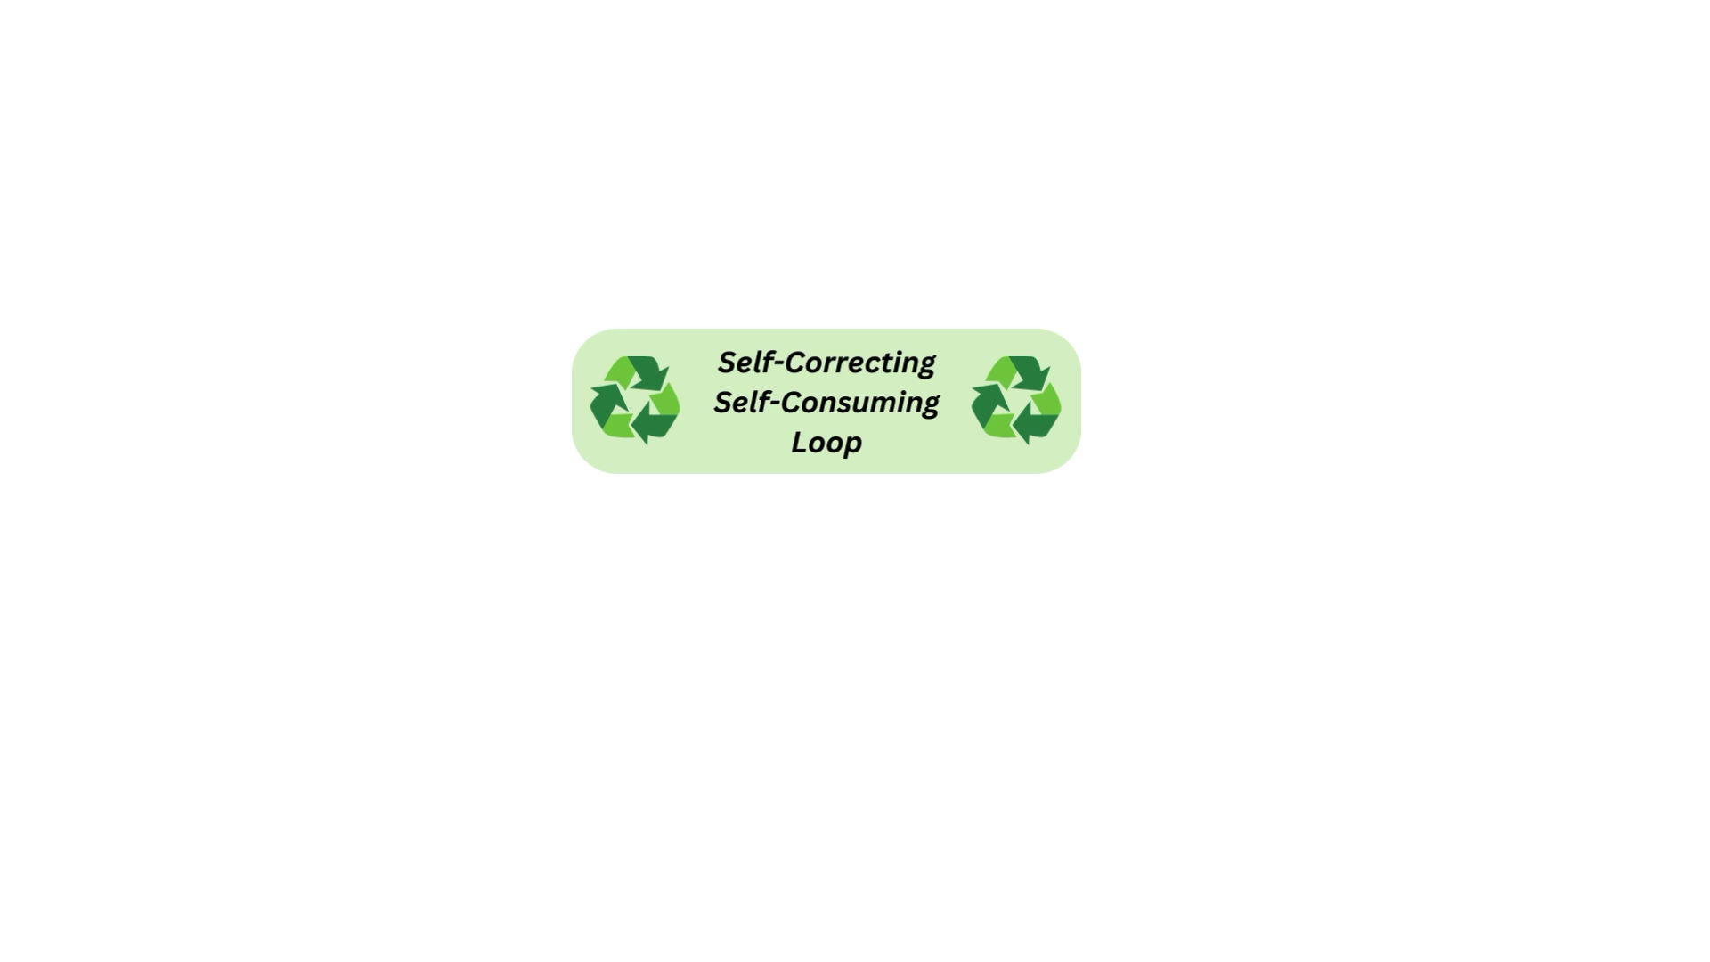
How? fixing motions using a physics simulator in “self-correcting self-consuming loop”

Slide 14
Self-correcting self-consuming does not go MAD
Correction function:
Tweak the generated joints so they can be executed by a simulated human

Slide 15
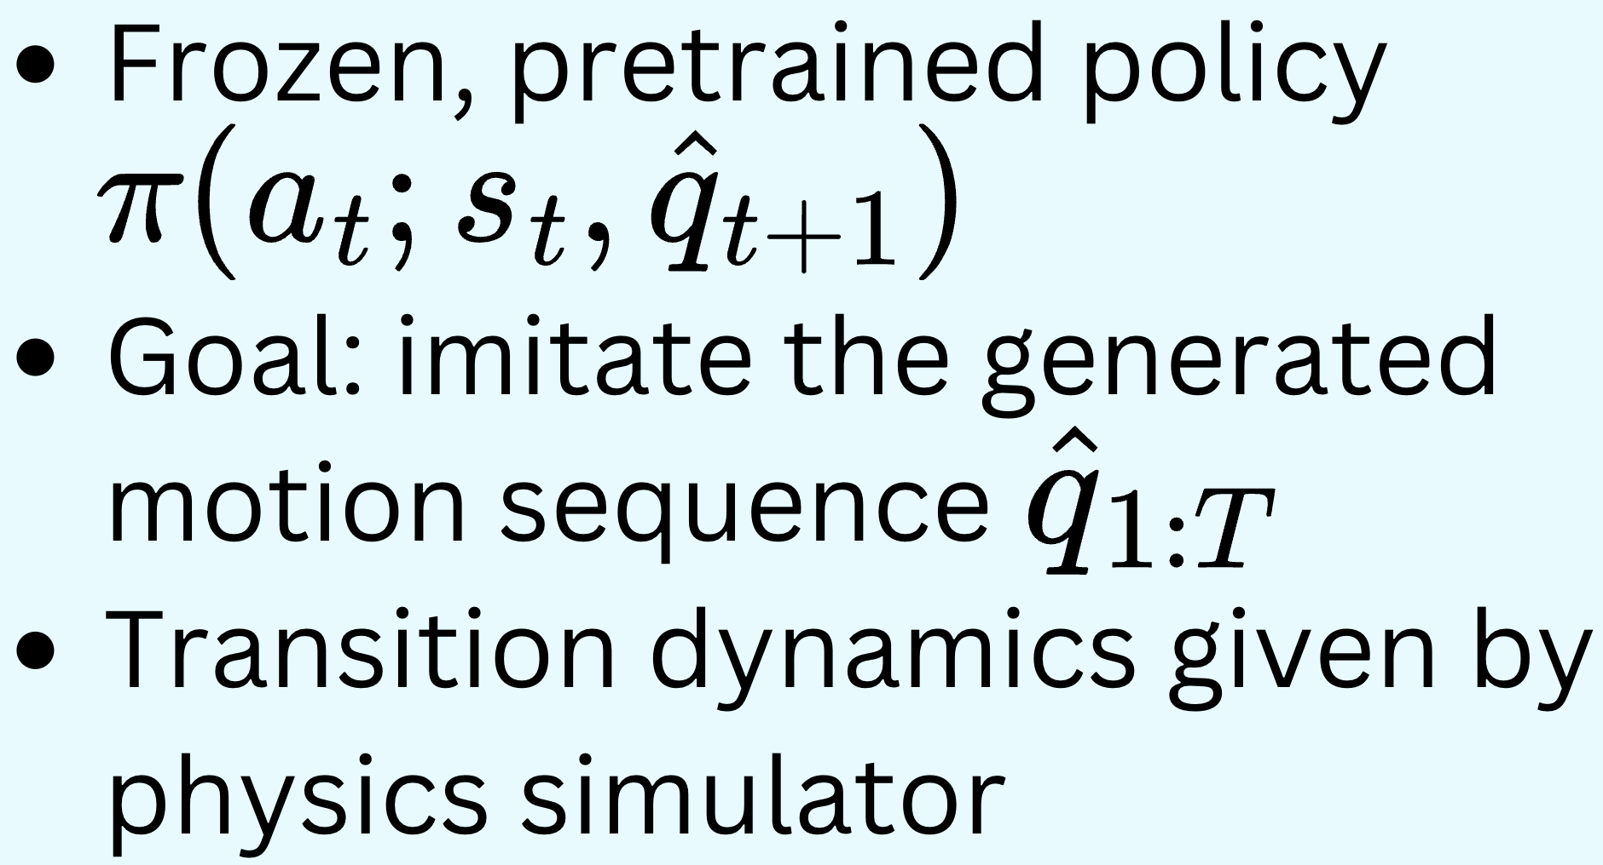
Zooming into the physics correction function
Universal Humanoid Control, Luo et al (2021)

Slide 16
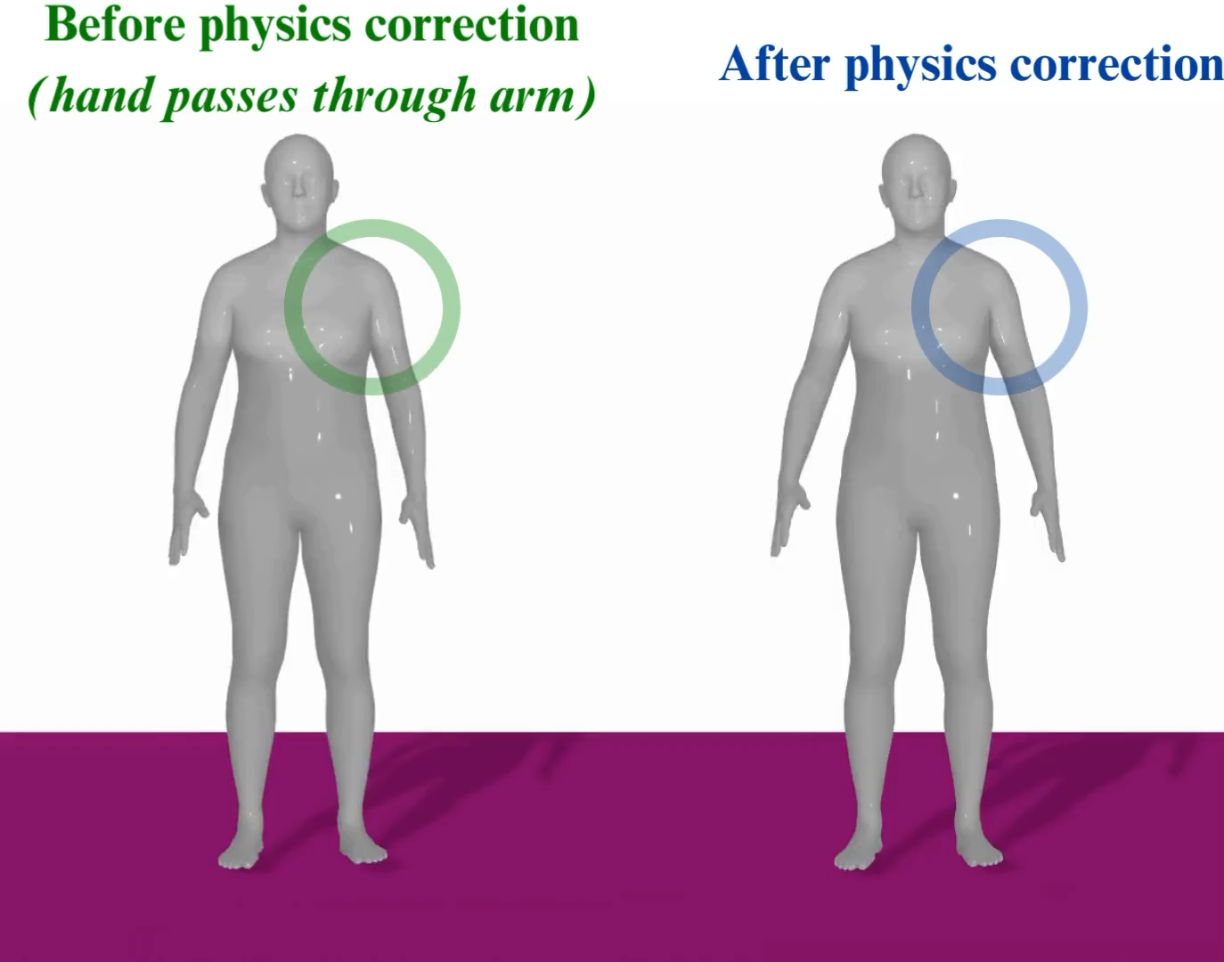
Zooming into the physics correction function

Slide 17
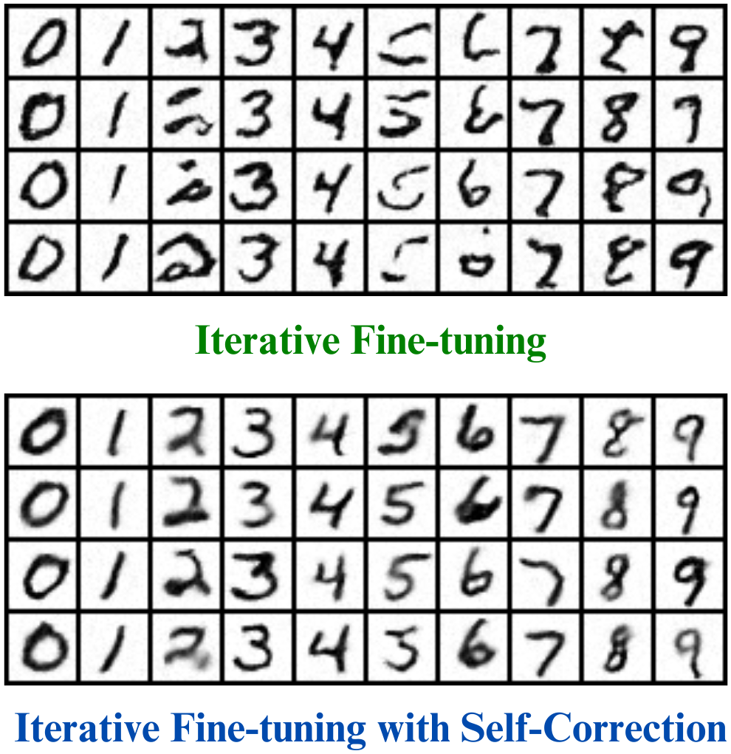
Follow-up questions 1. Self-consuming generative modeling How to stabilize self-consuming generative models for other modalities (e.g. text, image)?

Slide 18
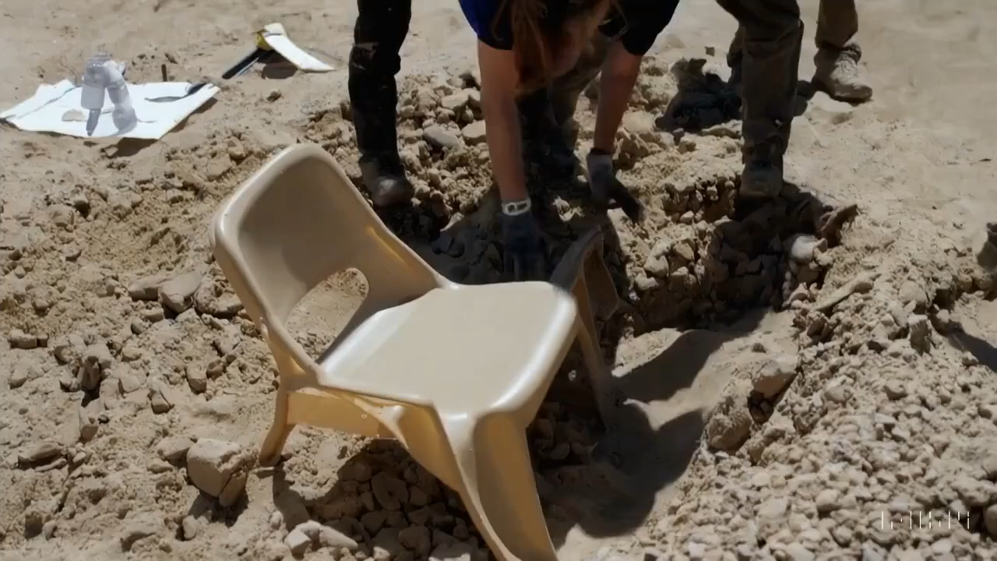
Follow-up questions 2. “Vanilla” generative modeling How to make general-purpose video generative models better understand physics?
OpenAI’s Sora https://www.youtube.com/watch?v=lfbImB0_rKY&ab_channel=Newsshooter

Slide 19






My awesome collaborators + advisors

